Slide 1
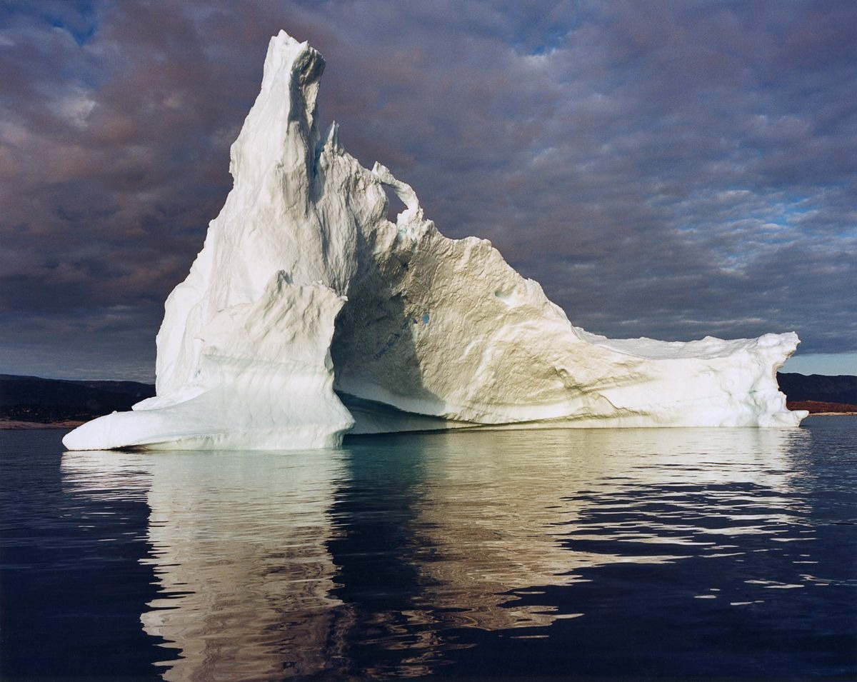
THE ARCTIC DEATH SPIRAL
A Time Series Analysis
Mentored by:
Prof. Leena Kulkarni
Prof. Prashant Dhamale
By:
Dharmi Gala A014
Taarishi Kothari A026
Mahi Shah A037
Rutvi Siriya A039
Notes:
Presenting a project

Slide 2
Table of Contents
What is Time Series Analysis and Forecasting?
Outline of the Phenomenon
Factors affecting Ice Melt
Arctic Amplification
Data Sources
Data Analysis
Implications
Conclusion & Solutions

Slide 3
Definition of TSA
An ordered sequence of values of a variable at equally spaced time intervals.
Data points taken over time may have an internal structure that should be accounted for.
The usage of time series models is twofold.
Obtain an understanding of the underlying forces and structure that produced the observed data.
Fit a model and proceed to forecasting, monitoring and improving present processes.
Notes:
2nd point acf pacf
5th point – residual, predicted, fitted, white noise

Slide 4



Scope
What is currently happening?
The crisis in the Arctic
Why is it a problem?
Why is this happening?
Climate Change
Global warming
What’s going to happen next?
Climatic catastrophe’s
Destruction of life and property

Slide 5
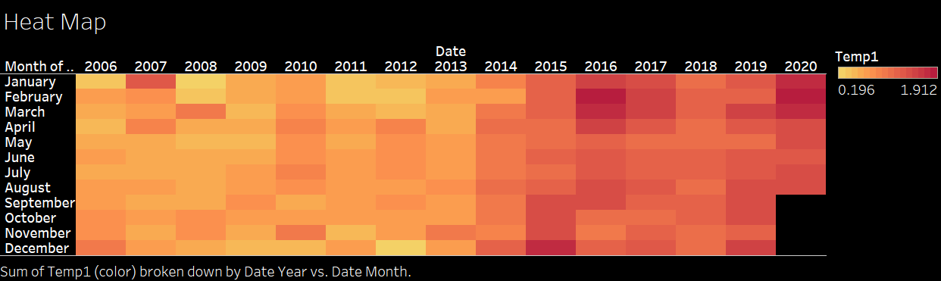

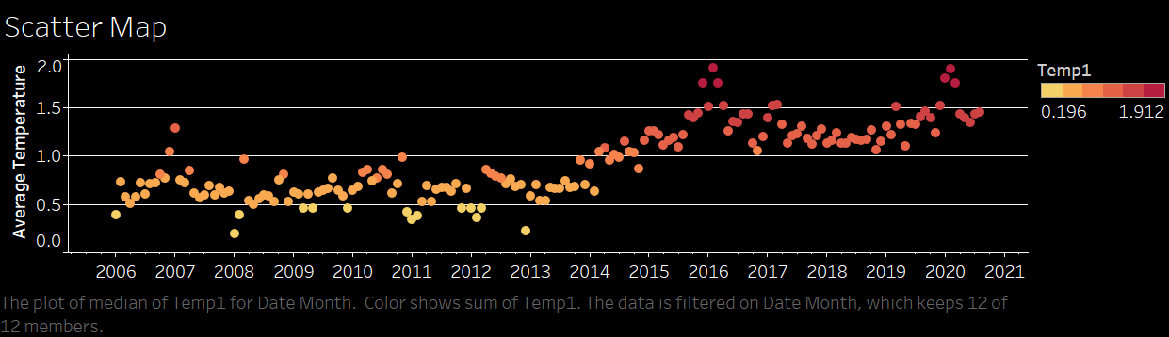
Factors Affecting Ice Melt
Temperature & Season
Arctic Amplification
Ozone Holes & Sunlight
Permafrost Thaw
Heatwaves
Oceanic Acidification
Greenhouse gasses

Slide 6
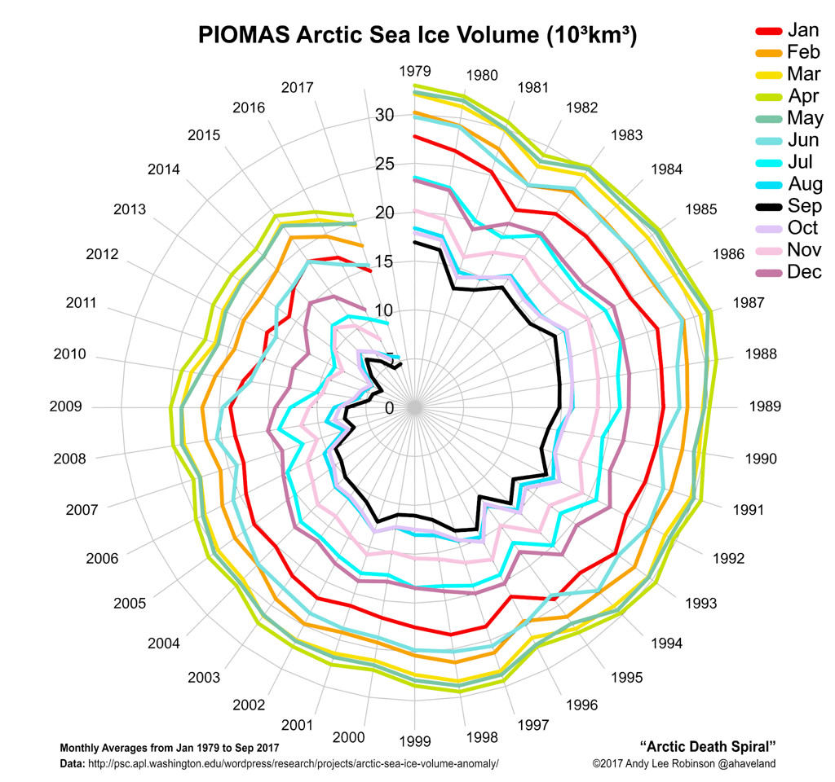
Data Sources:
Ice extent -
National Oceanic and Atmospheric Administration (NOAA)
Temperature -
Met Office Hadley Centre
About the data:
Monthly data ranging from January 2006 to August 2020
The data is from 2006 onwards because global warming has been at an all time high starting from the 21st Century.
The impacts of the crisis have been the most visible in recent years.
Notes:
Decreasing by 7.1% each year
Source- NOAA, NSIDC,

Slide 7
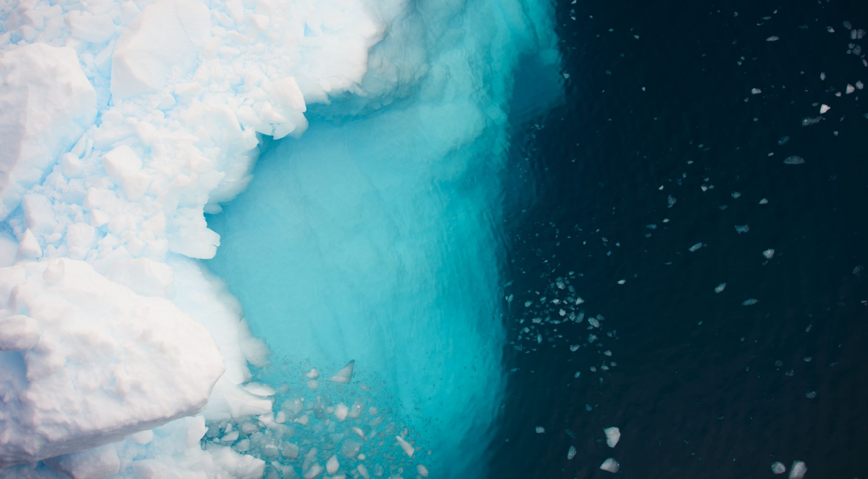
DATA ANALYSIS

Slide 8
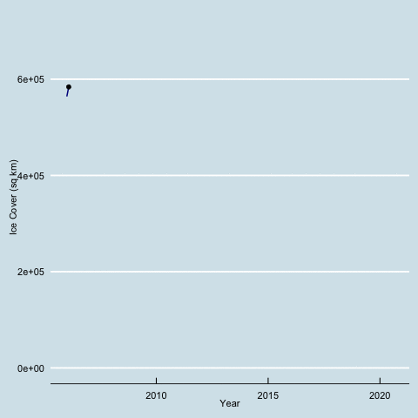
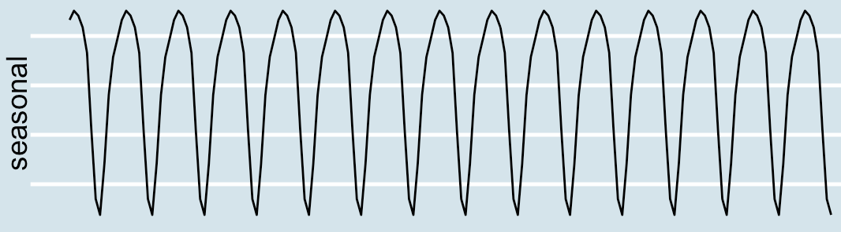
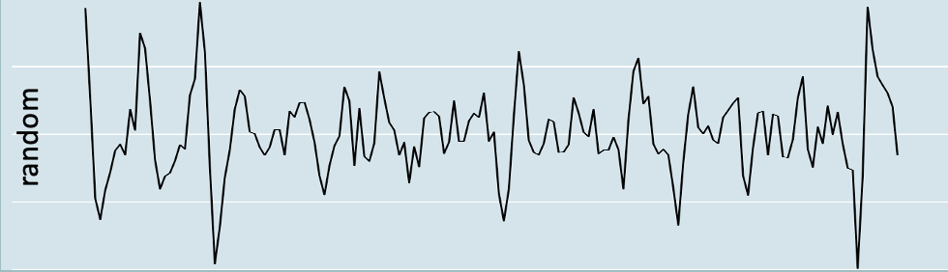
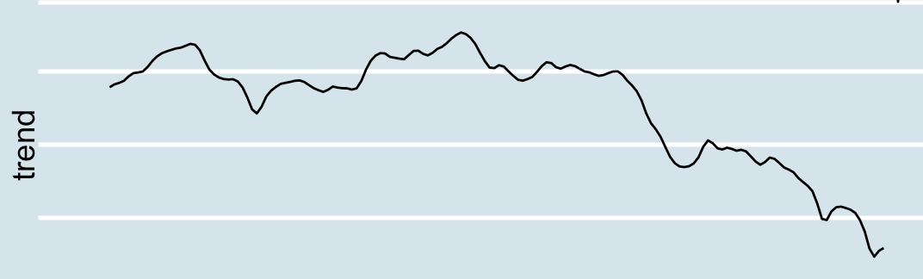
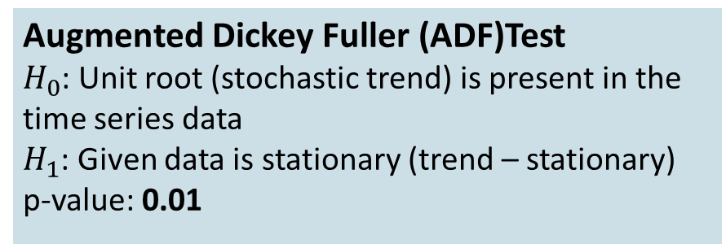
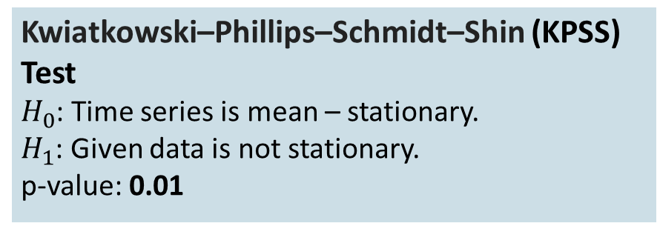
Time Profile
Augmented Dickey Fuller (ADF)Test
$H_{0}$: Unit root (stochastic trend) is present in the time series data
$H_{1}$: Given data is stationary (trend – stationary)
p-value: 0.01
Kwiatkowski–Phillips–Schmidt–Shin (KPSS) Test
$H_{0}$: Time series is mean – stationary.
$H_{1}$: Given data is not stationary.
p-value: 0.01
Notes:
A unit root refers to a stochastic trend in time series. Let me explain this with an easy example.

Slide 9
Forecast
Candidate Models
ETS MODEL
SARMA MODEL
SARIMA MODEL
MAPE: NA
MAPE: 703.17286
MAPE: 505.2825
HOLT WINTER’S MODEL
BATS MODEL
SARIMAX MODEL
SARIMAX MODEL
MAPE: NA
MAPE: 668.90047
MAPE: 503.06676
Notes:
BATS

Slide 10
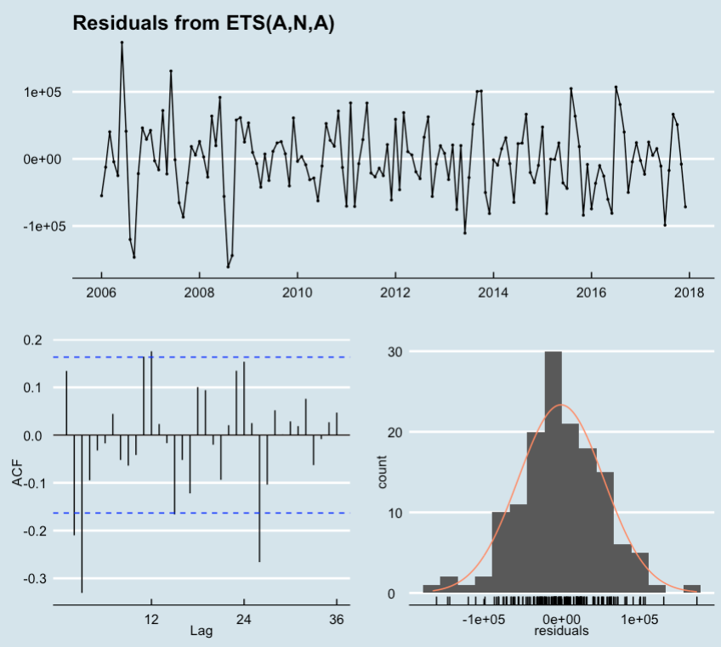


ETS Model
Error Trend Seasonal Model is an innovative state space model.
Let {y_{t} } be the ice extent time series
$$y_{t}=l_{t−1}+s_{t−m}+ε_{t}$$
$$l_{t}= l_{t−1}+0.9999ε_{t}$$
$$s_{t}=s_{t−m}+(e^{−4})ε_{t}$$
Ljung Box Test on Residuals:
$H_{0}$: Residuals are uncorrelated
p-value: 1.059e-08
MAPE: NA
Candidate Models
Notes:
Ets – full form

Slide 11
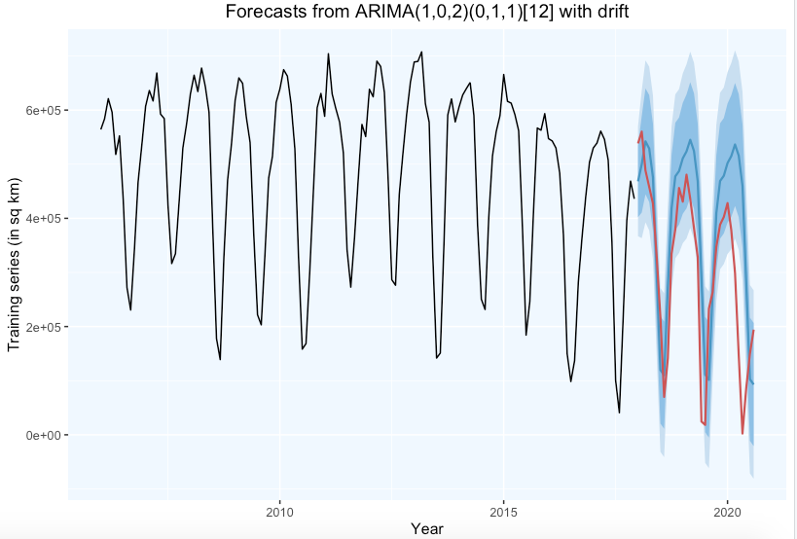



SARMA Model
ARIMA(1,0,2)(0,1,1)[12]
Let {Y_{t} } be the ice extent time series
$Z_{t}=∇^{D=12}Y_{t}$
$Z_{t}−0.3563Z_{t−1}=$
$μ+ε_{t}+0.5420ε_{t−1}+0.2854ε_{t−2}−0.5989ε_{t−12}$
Ljung Box Test on Residuals:
$H_{0}$: Residuals are uncorrelated
p-value: 0.4066
MAPE: 703.17286
Candidate Models
Notes:
Auto arima

Slide 12
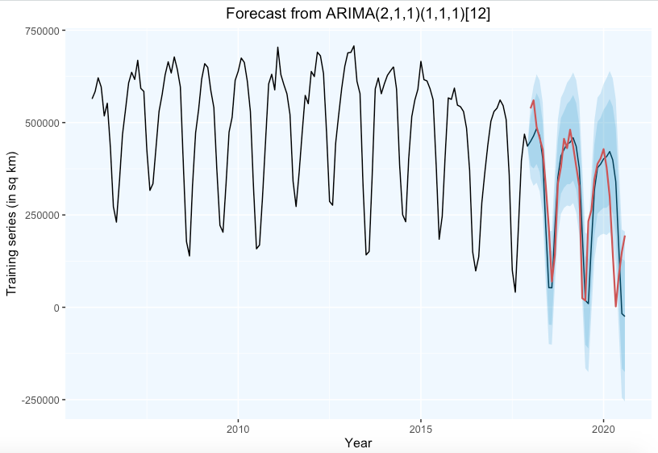
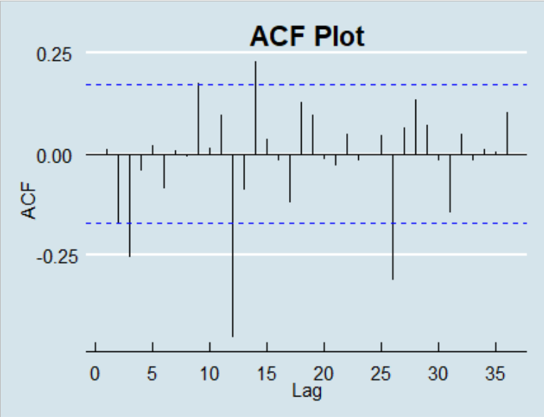
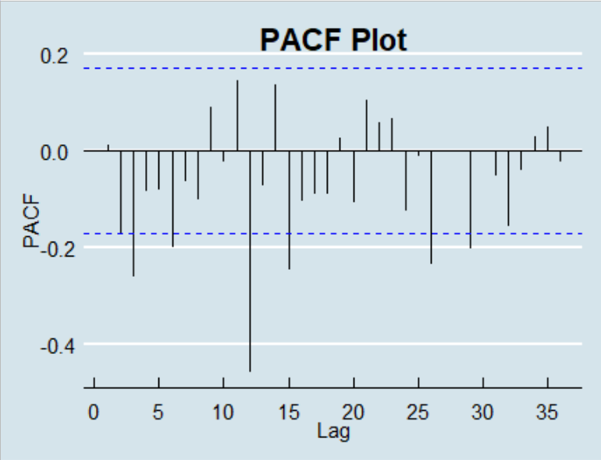



SARIMA Model
ARIMA(2,1,1)(1,1,1)[12]
Let {Y_{t} } be the ice extent time series
$Z_{t}=∇^{d=1, D=12}Y_{t}$
$Z_{t}−0.8331Z_{t−1}+0.2627Z_{t−2}+0.1463Z_{t−12}=$
$μ+ε_{t}−0.9224ε_{t−1}−0.5213ε_{t−12}$
Ljung Box Test on Residuals:
$H_{0}$: Residuals are uncorrelated
p-value: 0.2925
MAPE: 505.2825
Candidate Models
Notes:
Sarima 2

Slide 13
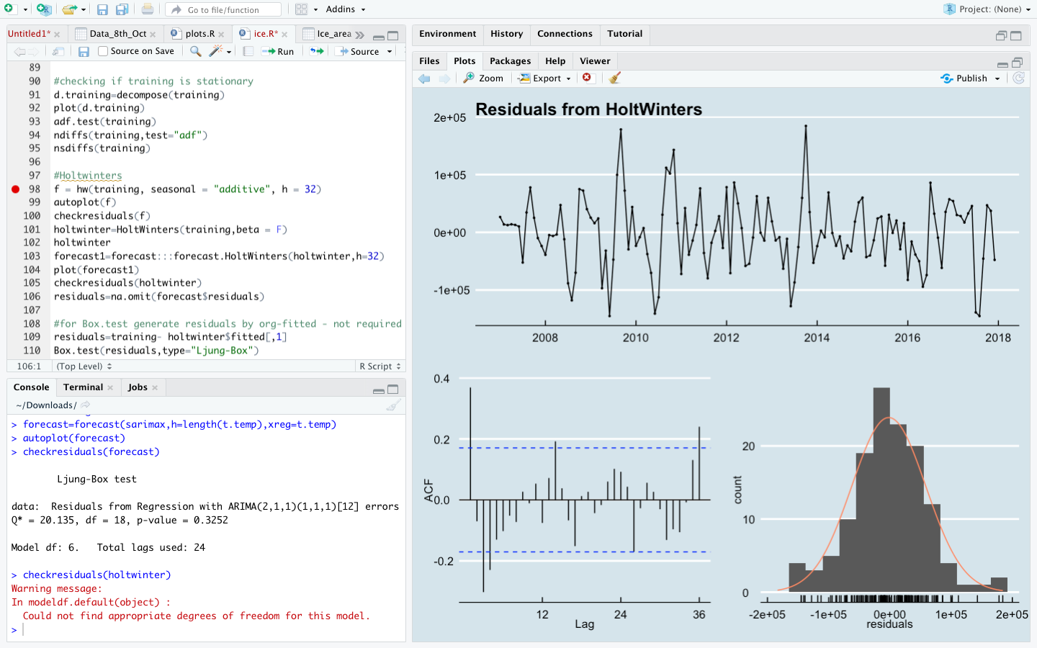


Holt Winter’s Model
Let $F_{t+m}$ = forecast of m periods beyond t
$$F_{t+m}= L_{t}+{mb}_{t}+S_{t+m−s}$$
where:
$$L_{t}=0.5403\left(y_{t}−S_{t−s}\right)+$$
$$0.4597(L_{t−1}+b_{t−1})$$
$$b_{t}=0.00724\left(L_{t}−L_{t−1}\right)+0.99276b_{t−1}$$
$$s_{t}=\left(y_{t}−L_{t}\right)$$
Ljung Box Test on Residuals:
$H_{0}$: Residuals are uncorrelated
p-value: 1.942e-05
MAPE: NA
Candidate Models
Notes:
Holt’s

Slide 14
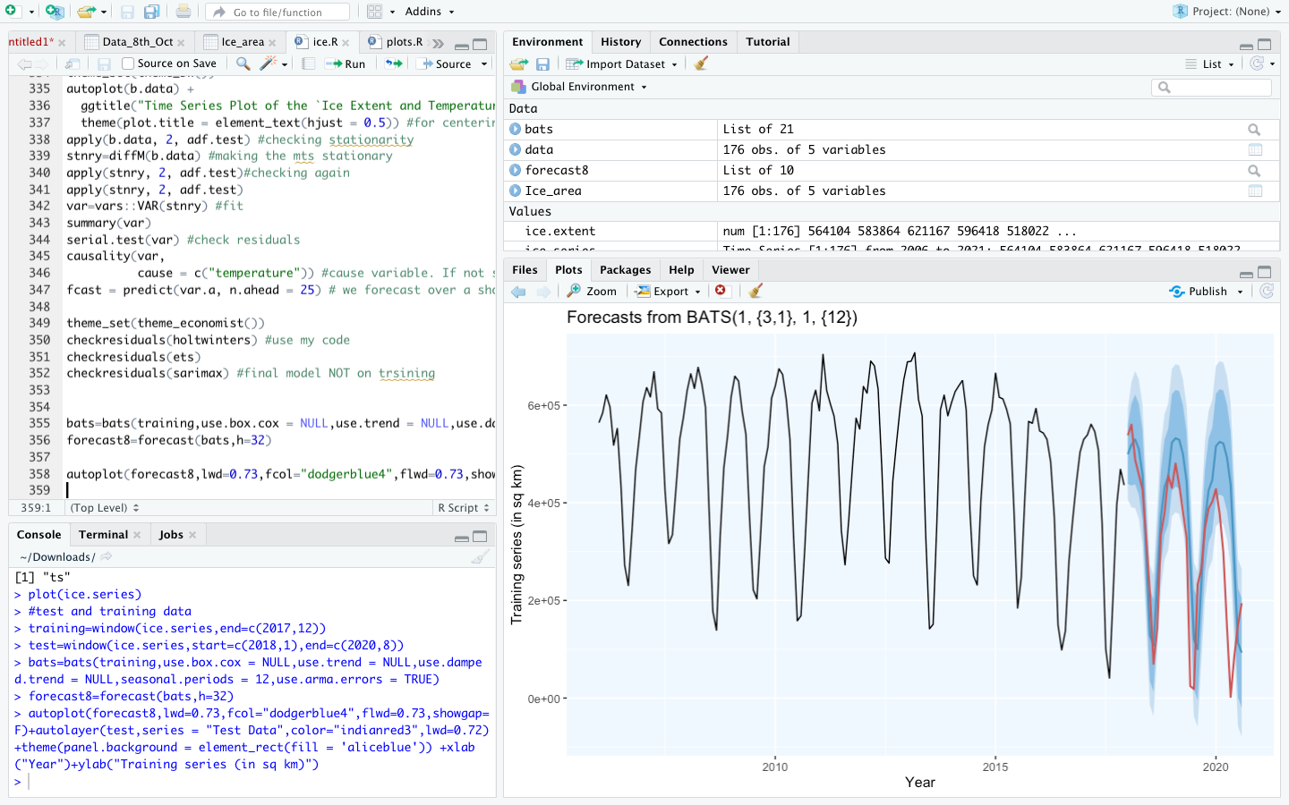

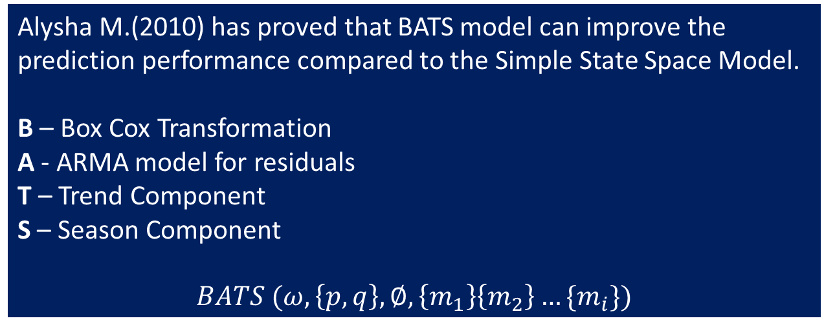

BATS Model
BATS (1, {3,1}, 1, {12})
Let {y_{t} } be the observation at time t
Alysha M.(2010) has proved that BATS model can improve the prediction performance compared to the Simple State Space Model.
B – Box Cox Transformation
A - ARMA model for residuals
T – Trend Component
S – Season Component
$$BATS (ω,\left\{p,q\right\},∅,\left\{m_{1}\right\}\left\{m_{2}\right\}…\{m_{i}\})$$
$$y_{t}^{(1)}=y_{t}$$
$$y_{t}^{\left(1\right)}=l_{t−1}+b_{t−1}+s_{t−m}+d_{t}$$
$l_{t}=l_{t−1}+b_{t−1 }+0.1065d_{t}$
$$b_{t}=b_{t−1 }+0.000164d_{t}$$
$$s_{t}=s_{t−m}−0.07608d_{t}$$
$$d_{t}=0.91448d_{t−1}$$
$$−0.3654d_{t−2}−0.0321d_{t−3}−0.0647ε_{t−1}+ε_{t}$$
Ljung Box Test on Residuals:
$H_{0}$: Residuals are uncorrelated
p-value: 0.9362
MAPE: 668.90047
Candidate Models
Notes:
Bats- check dt
Arma used to decorrelate time series data
Notation yt omega is used to represent the box cox transformation

Slide 15
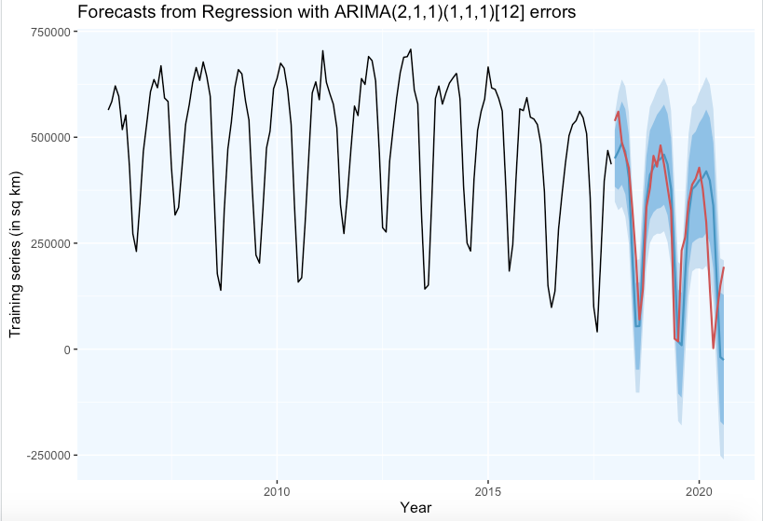
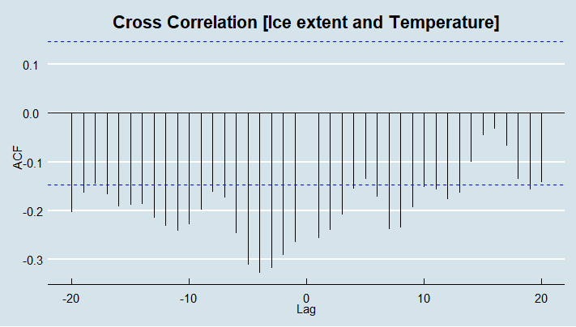



SARIMAX Model
ARIMA(2,1,1)(1,1,1) [12]with exogeneous variable
Let {Y_{t} } be ice extent time series
$Z_{t}=∇^{d=1, D=12}Y_{t}$
Let {X_{t} } be temperature time series
$Z_{t}−0.8342Z_{t−1}+0.2681Z_{t−2}+0.1513Z_{t−12}=$
$μ+ε_{t}−0.9213ε_{t−1}−0.5201ε_{t−12}$ - 8136.535 X_{t}
Ljung Box Test on Residuals:
$H_{0}$: Residuals are uncorrelated
p-value: 0.2722
MAPE: 503.06676
Candidate Models
Notes:
Sarimax
Endogenous: Input variables that are influenced by other variables in the system and on which the output variable depends.
Exogenous: Input variables that are not influenced by other variables in the system and on which the output variable depends.
cross correlation and an equation

Slide 16
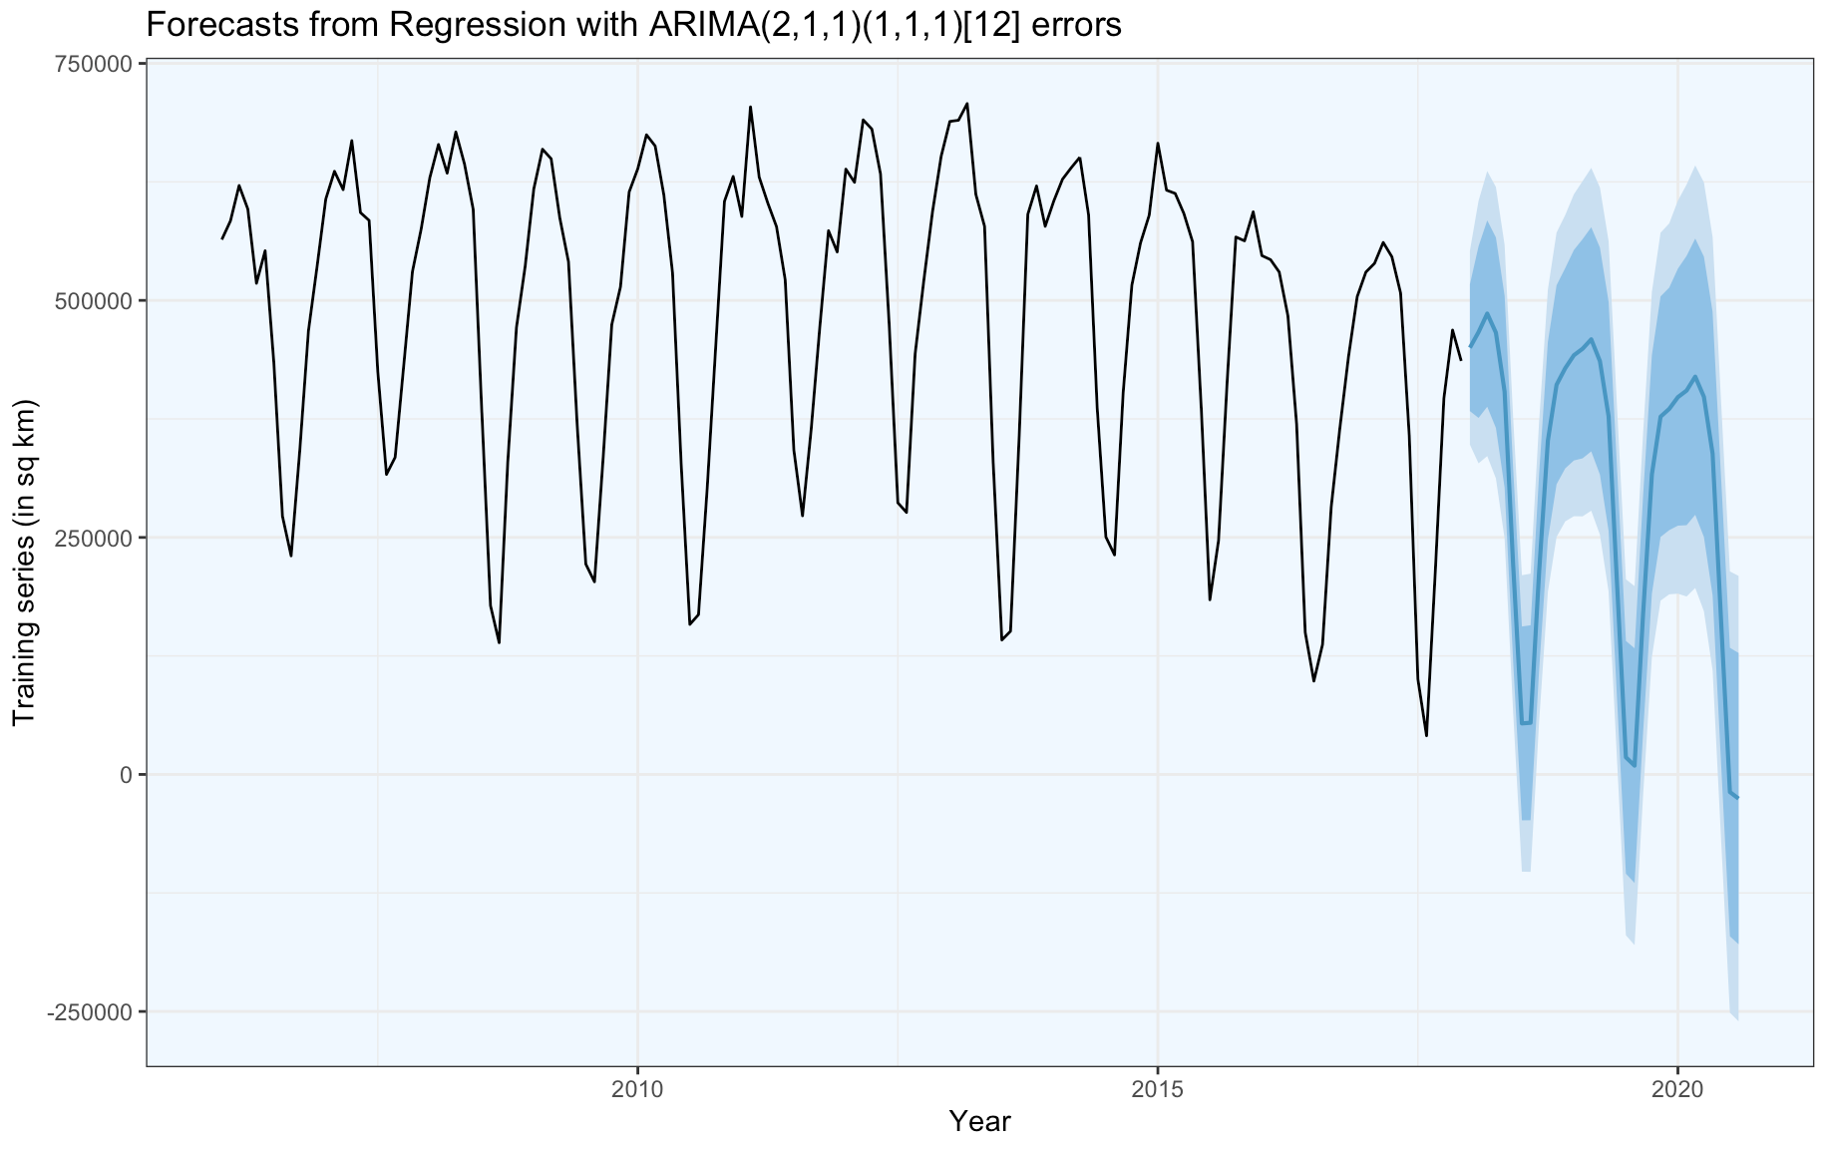
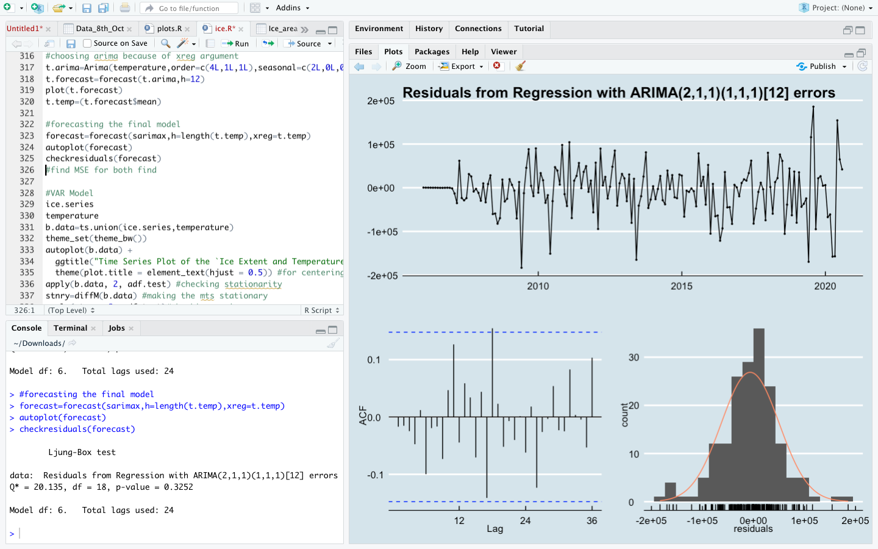


Forecast
$Z_{t}−0.8378Z_{t−1}+0.3710Z_{t−2}+0.1385Z_{t−12}=$
$μ+ε_{t}−0.9238ε_{t−1}−0.5955ε_{t−12}$ - 3.2273.69 X_{t}
Time | Forecast
Sep-20 | 218749.978
Oct-20 | 284244.078
Nov-20 | 295618.026
Dec-20 | 329238.037
Jan-21 | 366646.348
Feb-21 | 384654.577
Mar-21 | 344780.47
Apr-21 | 270060.31
May-21 | 190462.763
Jun-21 | 59101.733
Jul-21 | 7430.621
Aug-21 | 55936.685
For September 2020
Actual Extent (in sq km) | 239563.276
Percentage Error | 8.69%
Ljung Box Test on Residuals:
$H_{0}$: Residuals are uncorrelated
p-value: 0.3252
Notes:
Forecast – real values

Slide 17






Project analysis slide 6
Implications
Social Impacts
Coastal flooding
Displacement of residents
Climate
Heatwaves
Extreme Winters
Food & Vegetation
Unpredictable weather.
Food insecurity
Increase in Water Vapor
Traps Radiation
Heats the Arctic
Warmer Rivers
Rivers in Siberia, Canada
Inject more heat
Wildlife
Loss of habitat
Vulnerable communities
Albedo Effect
Increase in Regional and global temperatures
Permafrost
Methane gets released
Increase in temperatures

Slide 18
Solution
Meet the 1.5 degree C Paris agreement goals, for greenhouse emissions.
120 countries such as have committed to net zero emissions.
India must invest in mass public transport, sustainable construction and massive green cover.
Implement waste management systems and encourage small scale use of solar power.
Parking management, congestion pricing, cut trips by personal motor vehicles to half by 2031.
Sweden pledges to be carbon neutral by 2045, UK, France, New Zealand and Denmark by 2050.
Rain water harvesting, water shed management

Slide 19
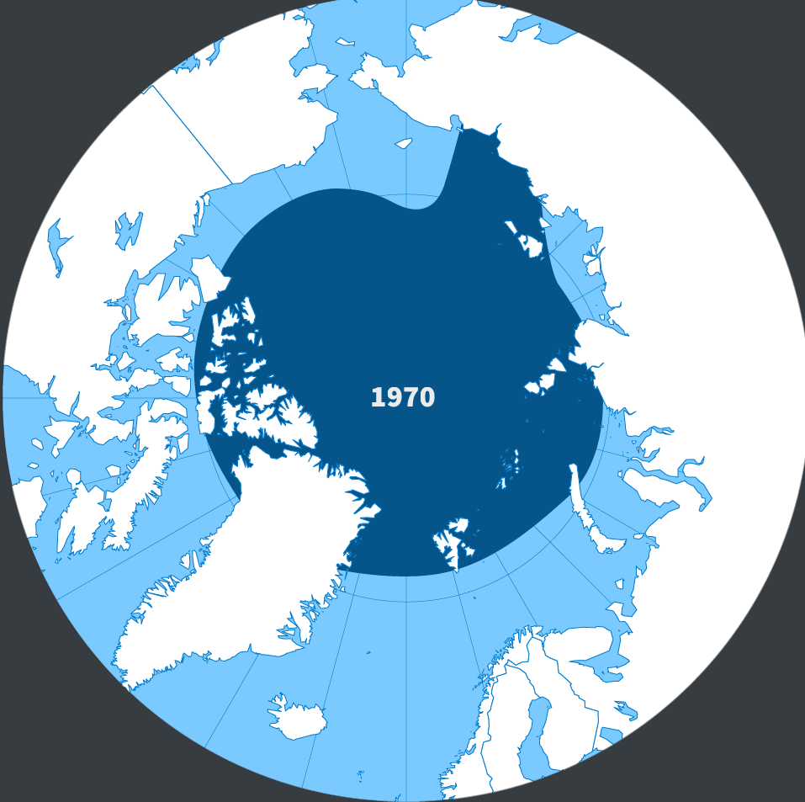
THANK YOU

